Slide 1
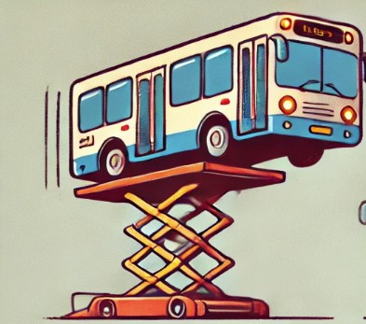
The Bus Is Up

Slide 2
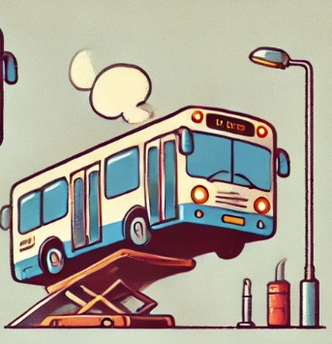
The Bus Is On

Slide 3
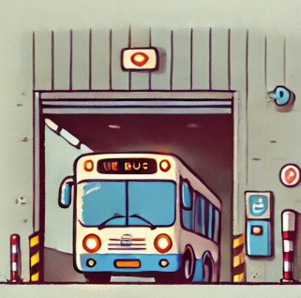
The Bus Is In

Slide 4
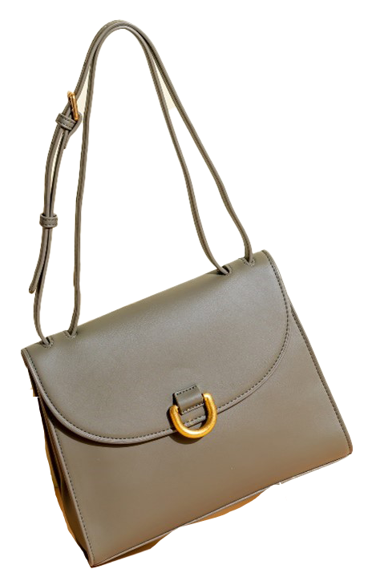
The Bag Is Up

Slide 5
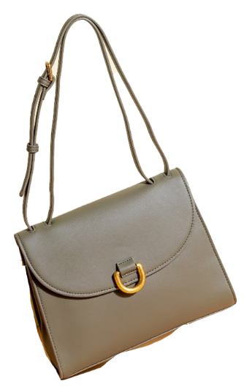
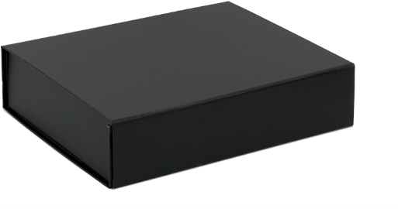
The Bag Is On

Slide 6
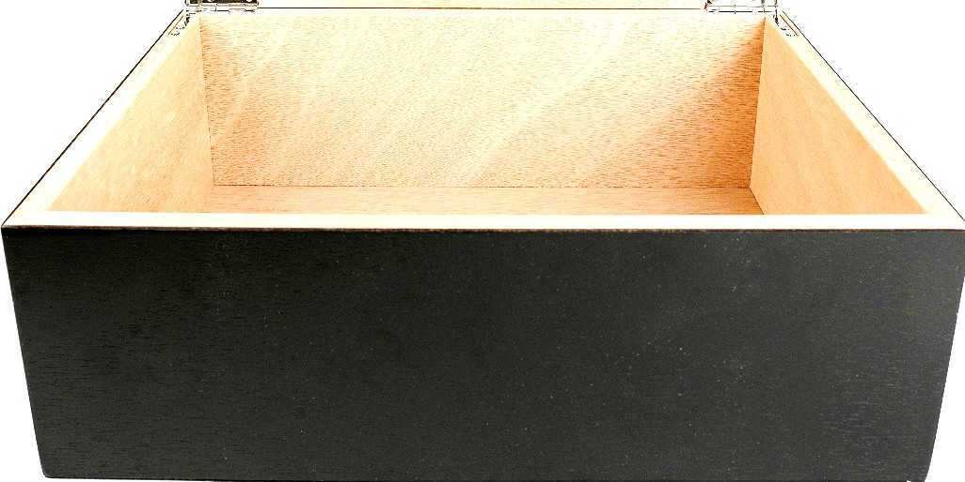
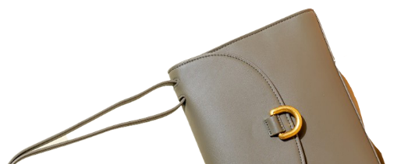
The Bag Is In

Slide 7
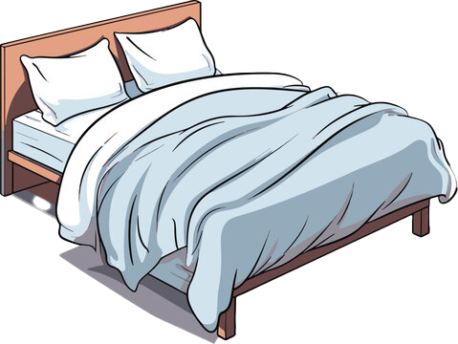
The Bed Is Up

Slide 8
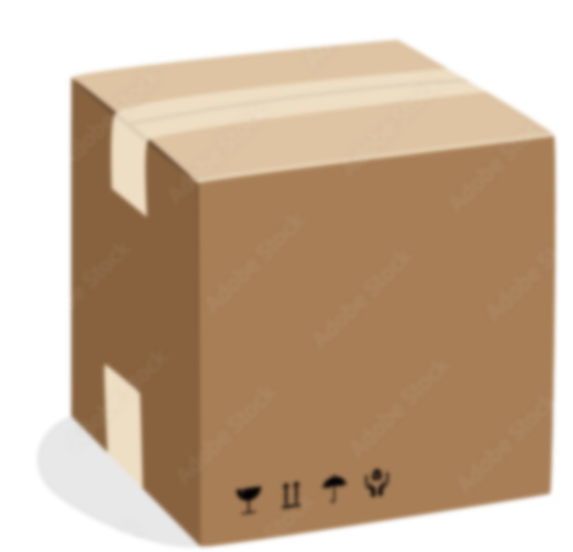
The Bed Is On

Slide 9
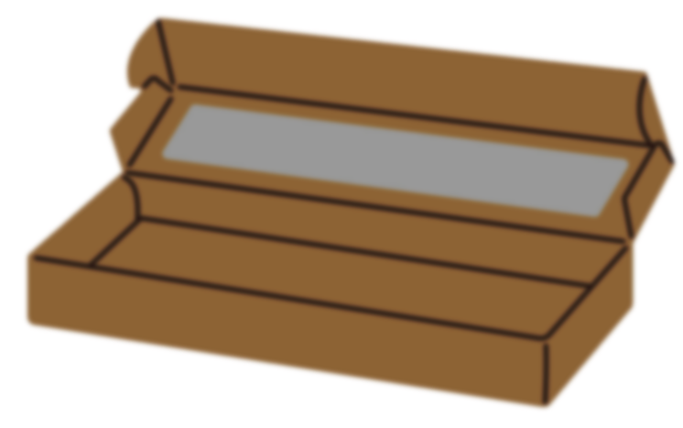

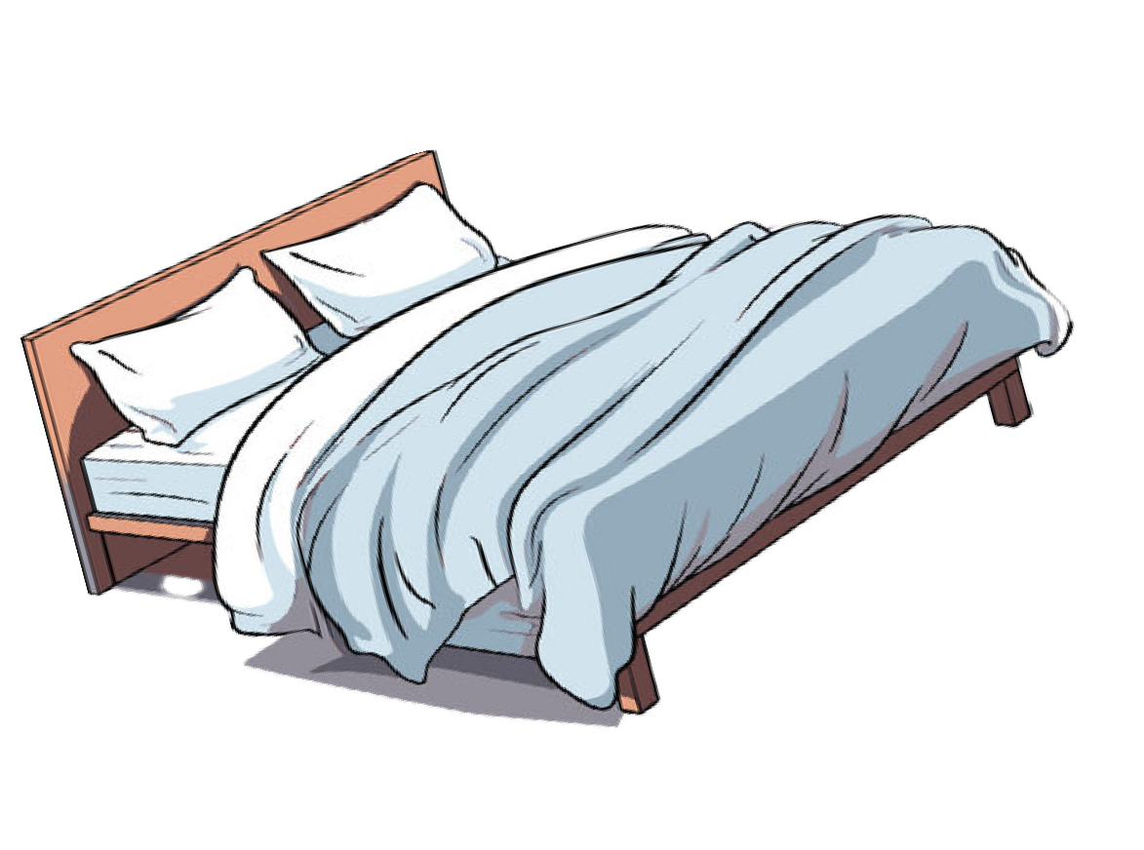



The Bed Is In

Slide 10





The Cat Is Up

Slide 11
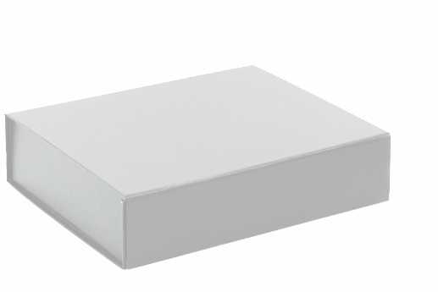


The Cat Is On

Slide 12
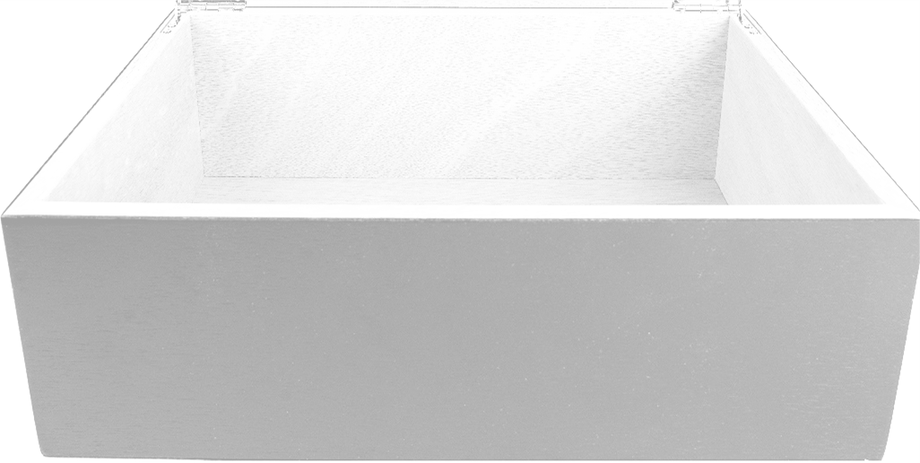

The Cat Is In

Slide 13
The Cat Is Up

Slide 14
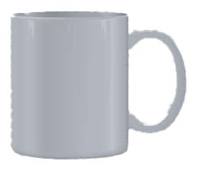
The Cup Is Up

Slide 15
The Cup Is On

Slide 16
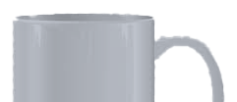
The Cup Is In

Slide 17

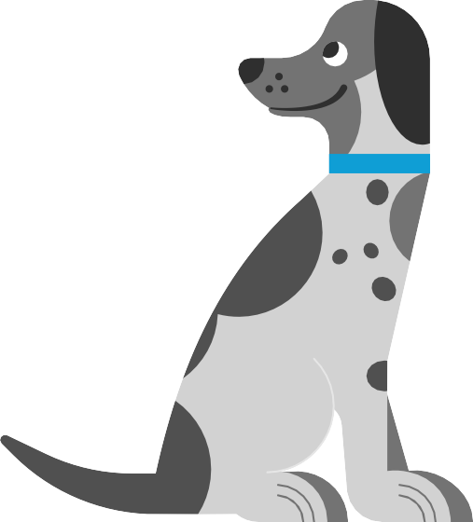
The Dog Is Up

Slide 18


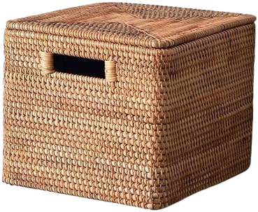
The Dog Is On

Slide 19


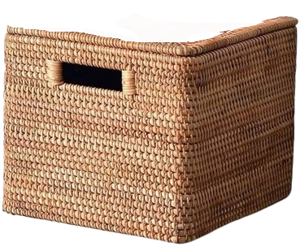
The Dog Is In

Slide 20

The Dot Is Up

Slide 21
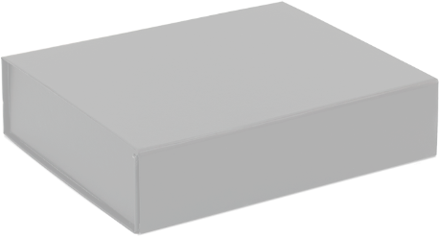

The Dot Is On

Slide 22

The Dot Is In

Slide 23
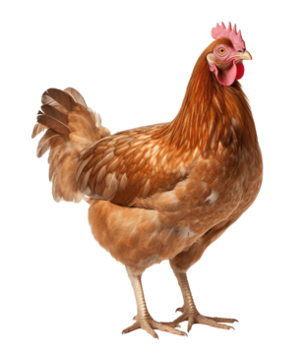
The Hen Is UP

Slide 24
The Hen Is On

Slide 25
The Hen Is In

Slide 26

The Log Is Up

Slide 27
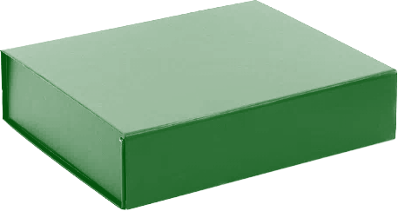
The Log Is On

Slide 28
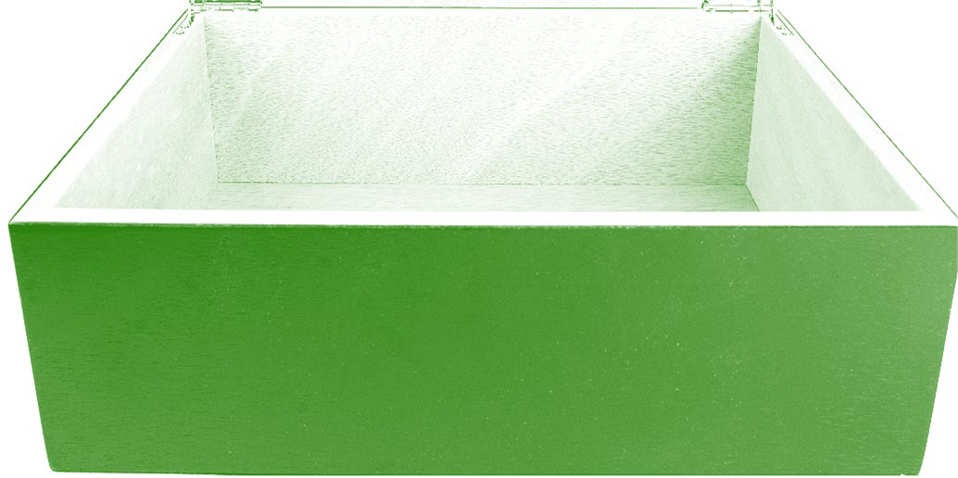

The Log Is In

Slide 29
The Map Is Up

Slide 30

The Map Is On

Slide 31
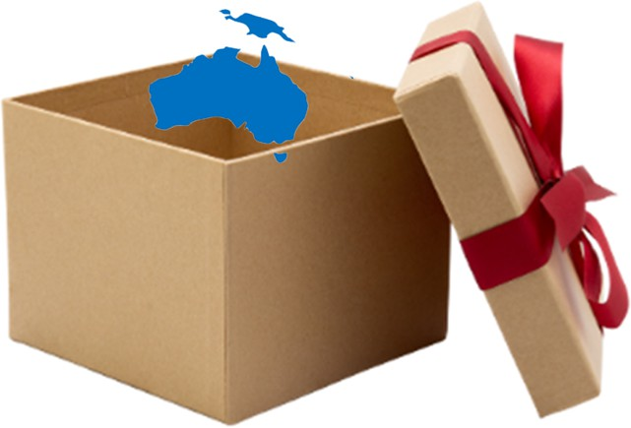
The Map Is In

Slide 32
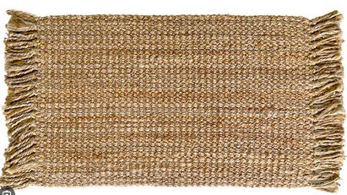
The Mat Is Up

Slide 33
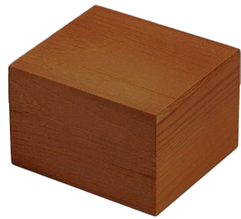
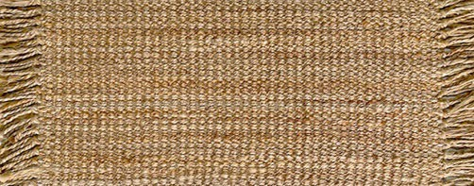
The Mat Is On

Slide 34
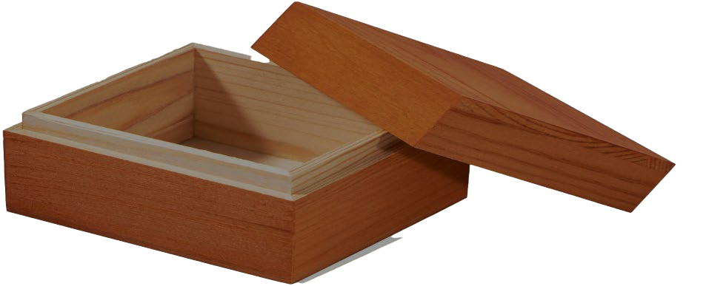
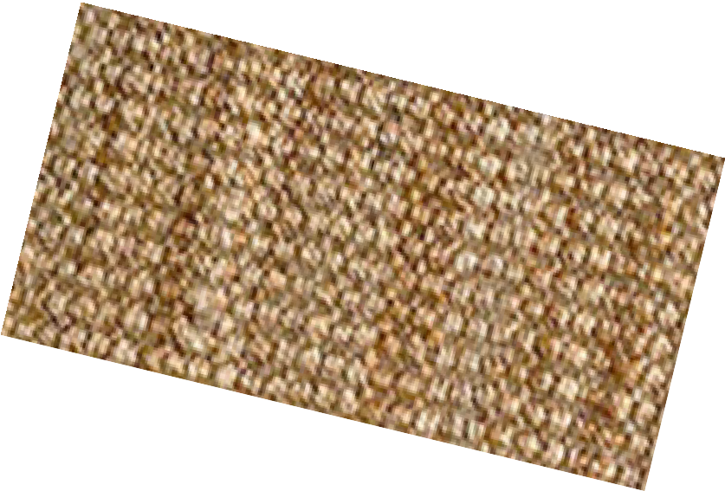
The Mat Is In

Slide 35
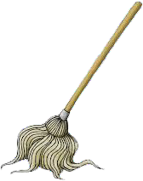
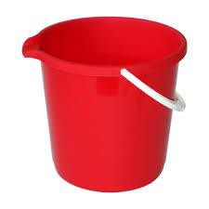
The Mop Is Up

Slide 36
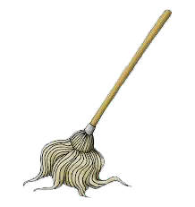
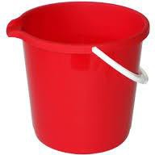
The Mop Is On

Slide 37
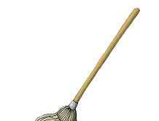
The Mop Is In

Slide 38

The Mud Is Up

Slide 39
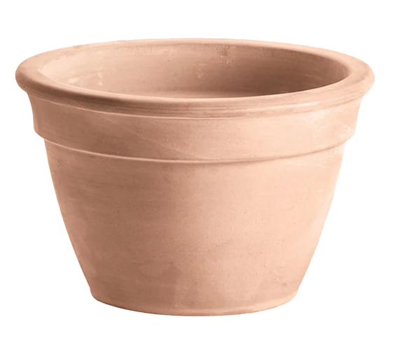
The Mud Is On

Slide 40

The Mud Is In

Slide 41
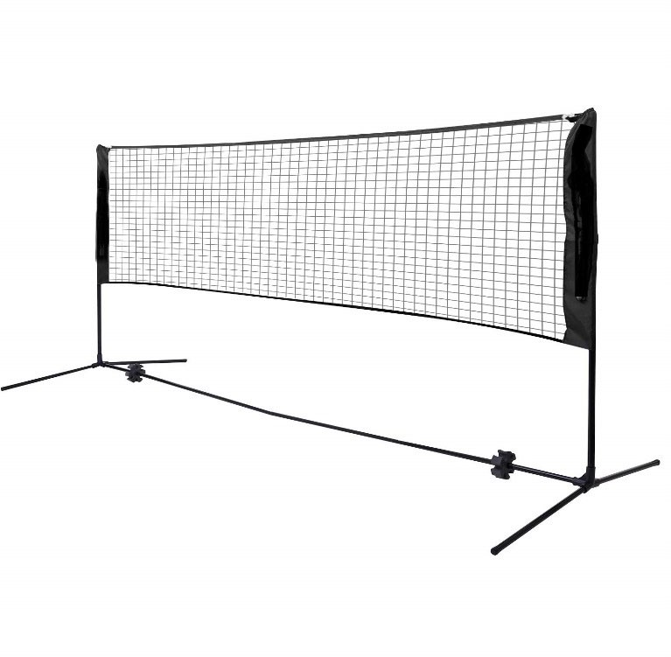
The Net Is Up

Slide 42
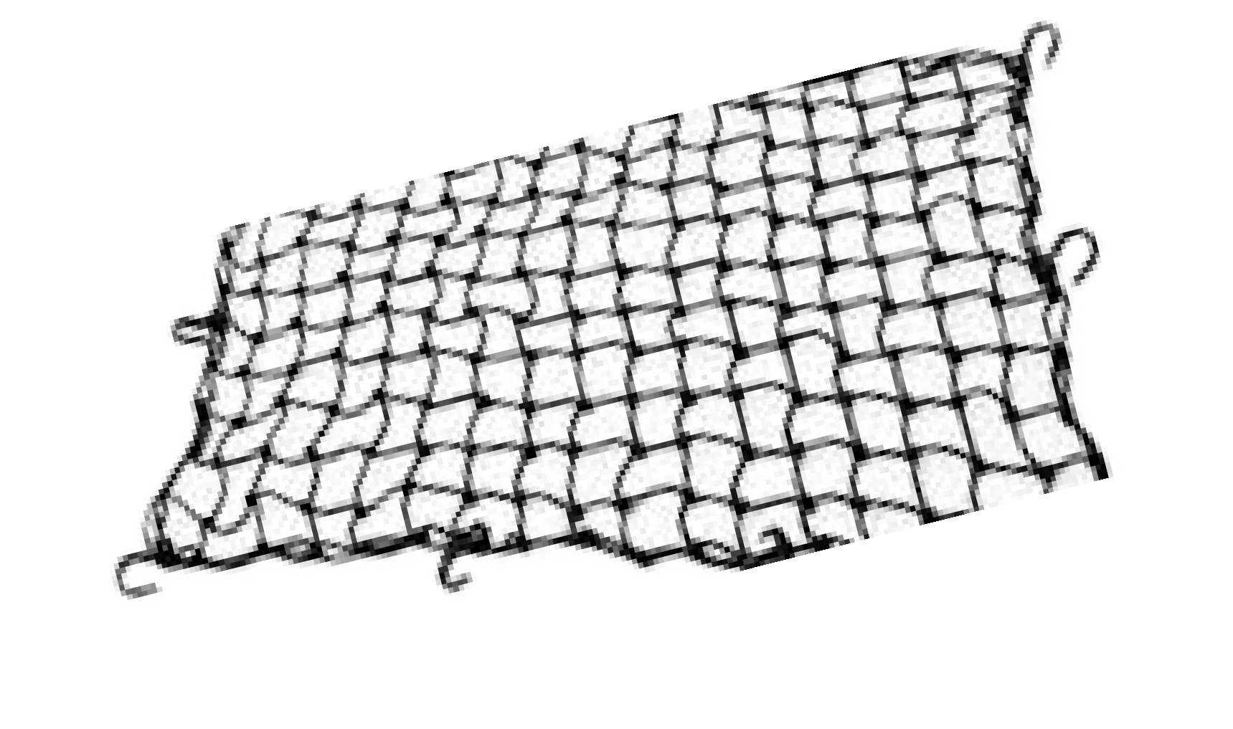
The Net Is On

Slide 43
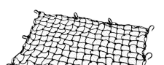
The Net Is In

Slide 44
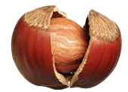
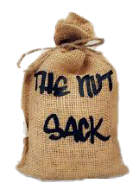
The Nut Is Up

Slide 45
The Nut Is On

Slide 46
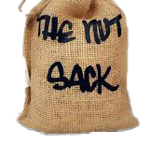
The Nut Is In

Slide 47
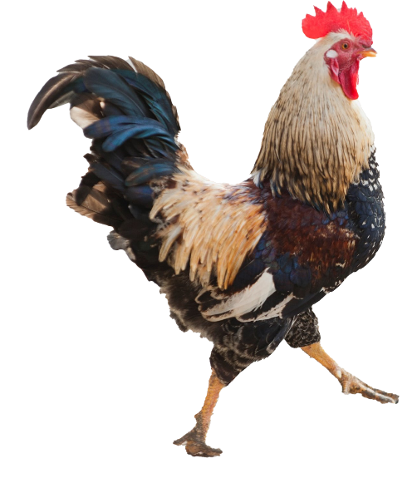
The Pet Is Up

Slide 48

The Pet Is On

Slide 49

The Pet Is In

Slide 50
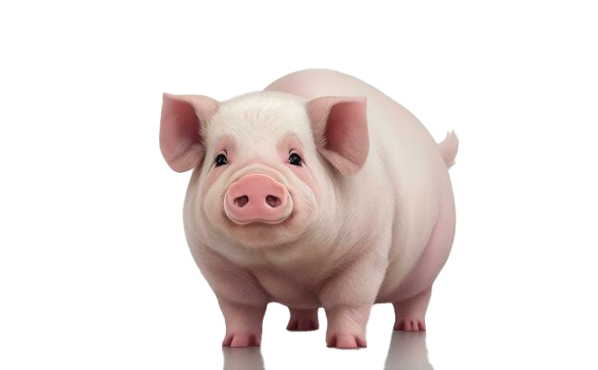
The Pig Is Up

Slide 51
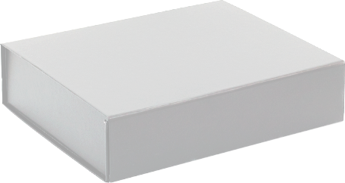
The Pig Is On

Slide 52
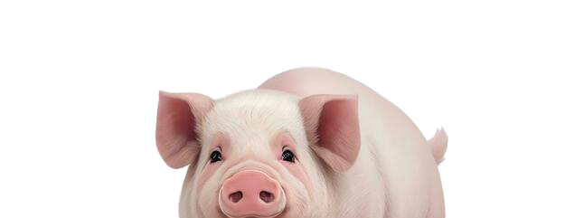
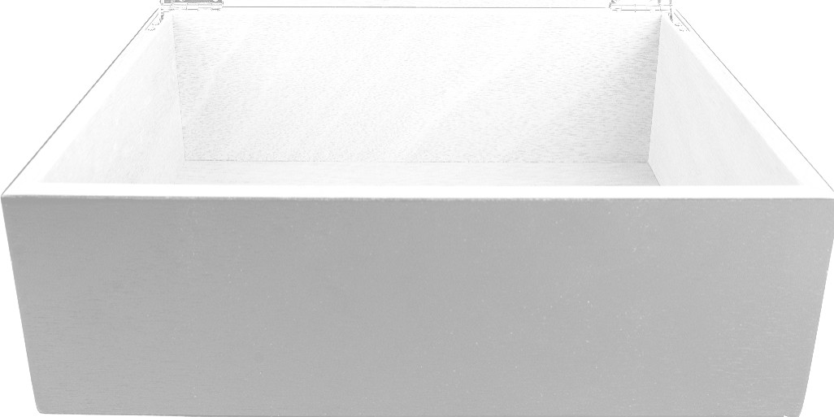
The Pig Is In

Slide 53

The Pin Is Up

Slide 54
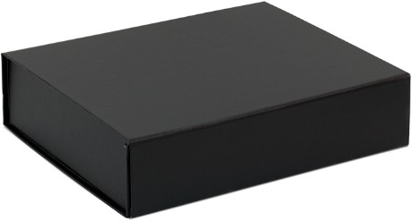
The Pin Is On

Slide 55
The Pin Is In

Slide 56
The Pot Is Up

Slide 57

The Pot Is On

Slide 58
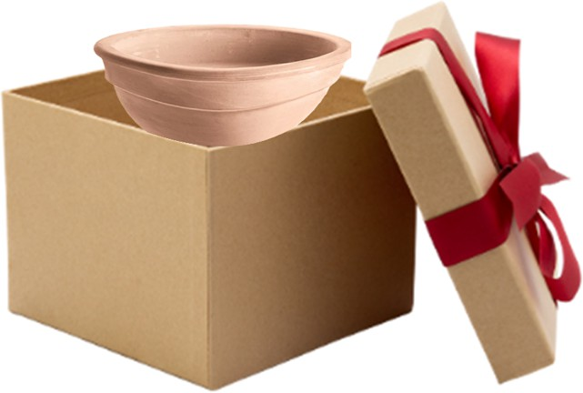
The Pot Is In

Slide 59
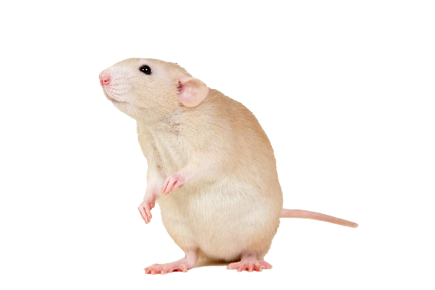
The Rat Is Up

Slide 60
The Rat Is On

Slide 61
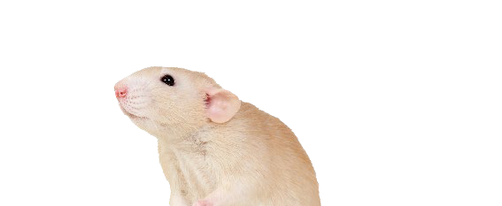
The Rat Is In

Slide 62


The Tap Is Up

Slide 63




The Tap Is On

Slide 64





The Tap Is In

Slide 65

The Tin Is Up

Slide 66

The Tin Is On

Slide 67


The Tin Is In

Slide 68

The VAN Is Up

Slide 69

The VAN Is On

Slide 70

The VAN Is In

Slide 71
The Web Is Up

Slide 72
The Web Is On

Slide 73

The Web Is In

